Slide 1
Machine Learning

Slide 2
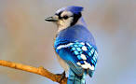
But figuring out how to make a computer recognize objects has puzzled the very best computer scientists for over 50 years.
In the last few years, we’ve finally found a good approach to object recognition using deep neural networks.

Slide 3
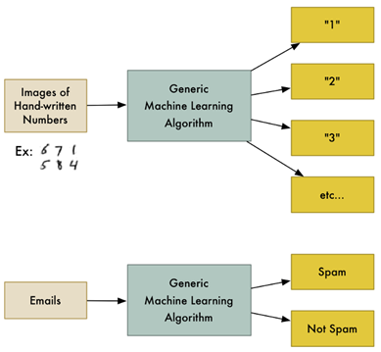
The same classification algorithm used to recognize handwritten numbers could also be used to classify emails into spam and not-spam without changing a line of code. It’s the same algorithm but it’s fed different training data so it comes up with different classification logic.
“Machine learning” is an umbrella term covering lots of these kinds of generic algorithms.

Slide 4
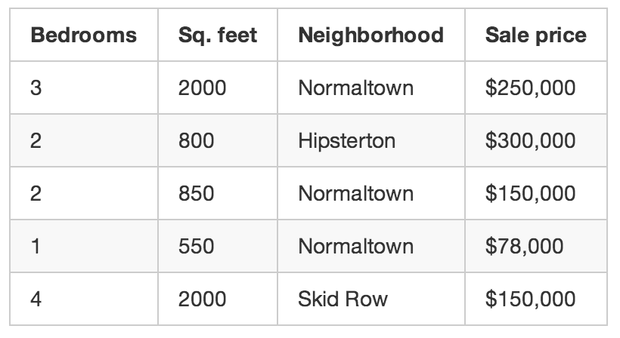
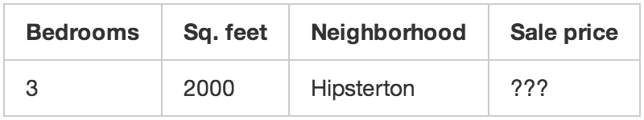
Supervised Learning
3 months historical data
Using that training data, we want to create a program that can estimate how much any other house in your area is worth:
If you sell houses for a long time, you will instinctively have a “feel” for the right price for a house, the best way to market that house, the kind of client who would be interested, etc. The goal of Strong AI research is to be able to replicate this ability with computers.

Slide 5
But current machine learning algorithms aren’t that good yet — they only work when focused a very specific, limited problem. Maybe a better definition for “learning” in this case is “figuring out an equation to solve a specific problem based on some example data”.
Unfortunately “Machine Figuring out an equation to solve a specific problem based on some example data” isn’t really a great name. So we ended up with “Machine Learning” instead.

Slide 6
def estimate_house_sales_price(num_of_bedrooms, sqft, neighborhood):
price = 0
# In my area, the average house costs $200 per sqft
price_per_sqft = 200
if neighborhood == "hipsterton":
# but some areas cost a bit more
price_per_sqft = 400
elif neighborhood == "skid row":
# and some areas cost less
price_per_sqft = 100
# start with a base price estimate based on how big the place is
price = price_per_sqft * sqft
# now adjust our estimate based on the number of bedrooms
if num_of_bedrooms == 0:
# Studio apartments are cheap
price = price — 20000
else:
# places with more bedrooms are usually
# more valuable
price = price + (num_of_bedrooms * 1000)
return price
Wouldn’t it be better if the computer could just figure out how to implement this function for you? Who cares what exactly the function does as long is it returns the correct number:
def estimate_house_sales_price(num_of_bedrooms, sqft, neighborhood):
price = <computer, plz do some math for me>
return price

Slide 7
One way to think about this problem is that the price is a delicious dish and the ingredients are the number of bedrooms, the square footage and the neighborhood. If you could just figure out how much each ingredient impacts the final price, maybe there’s an exact ratio of ingredients to stir in to make the final price.
def estimate_house_sales_price(num_of_bedrooms, sqft, neighborhood):
price = 0
# a little pinch of this
price += num_of_bedrooms * .841231951398213
# and a big pinch of that
price += sqft * 1231.1231231
# maybe a handful of this
price += neighborhood * 2.3242341421
# and finally, just a little extra salt for good measure
price += 201.23432095
return price
Notice the magic numbers in bold — .841231951398213, 1231.1231231, 2.3242341421, and 201.23432095.
These are our weights. If we could just figure out the perfect weights to use that work for every house, our function could predict house prices!

Slide 8
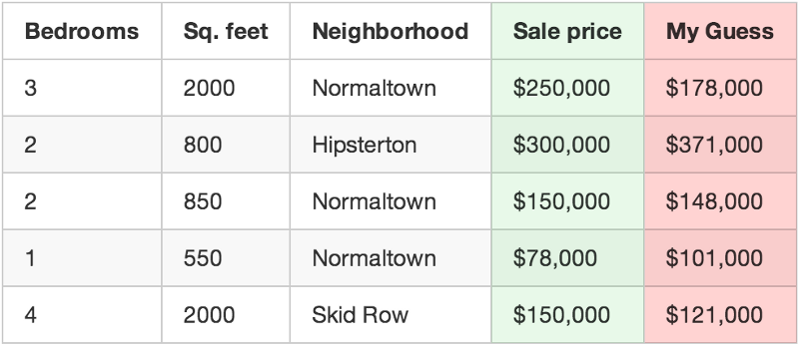
off by $72,000
off by $-71,000
For example, if the first house really sold for $250,000, but your function guessed it sold for $178,000, you are off by $72,000 for that single house.
Now add up the squared amount you are off for each house you have in your data set. Let’s say that you had 500 home sales in your data set and the square of how much your function was off for each house was a grand total of $86,123,373. That’s how “wrong” your function currently is.
Now, take that sum total and divide it by 500 to get an average of how far off you are for each house. Call this average error amount the cost of your function.
If you could get this cost to be zero by playing with the weights, your function would be perfect. It would mean that in every case, your function perfectly guessed the price of the house based on the input data. So that’s our goal — get this cost to be as low as possible by trying different weights.

Slide 9
Research in many fields over the last 40-50 years has shown that these generic learning algorithms that “stir the number” out-perform approaches where real people try to come up with explicit rules themselves.
The “dumb” approach of machine learning eventually beats human experts.
The function we ended up with is totally dumb. It doesn’t even know what “square feet” or “bedrooms” are. All it knows is that it needs to stir in some amount of those numbers to get the correct answer.
It’s very likely you’ll have no idea why a particular set of weights will work. So you’ve just written a function that you don’t really understand but that you can prove will work.
Imagine that instead of taking in parameters like “sqft” and “num_of_bedrooms”, your prediction function took in an array of numbers. Let’s say each number represented the brightness of one pixel in an image captured by camera mounted on top of your car. Now let’s say that instead of outputting a prediction called “price”, the function outputted a prediction called “degrees_to_turn_steering_wheel”.
We’ve just made a function that can steer the car by itself!

Slide 10
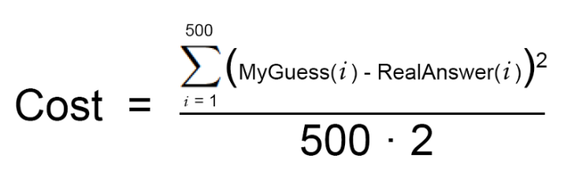
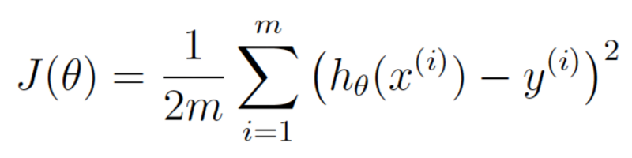
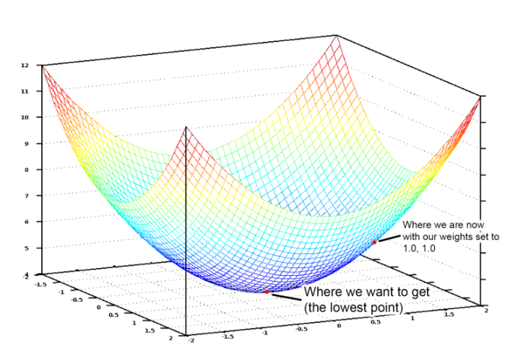
Θ is weight and J(θ) is cost at given θ
So we just need to adjust our weights so we are “walking down hill” on this graph towards the lowest point
So if we calculate a partial derivative of our cost function with respect to each of our weights, then we can subtract that value from each weight. That will walk us one step closer to the bottom of the hill. Keep doing that and eventually we’ll reach the bottom of the hill and have the best possible values for our weights. gradient descent
The three-step algorithm I described is called multivariate linear regression.

Slide 11
This approach works in simple cases, it won’t work in all cases. One reason is because house prices aren’t always simple enough to follow a continuous line.
But luckily there are lots of ways to handle that. There are plenty of other machine learning algorithms that can handle non-linear data (like neural networks or SVMs with kernels).
There are also ways to use linear regression more cleverly that allow for more complicated lines to be fit.
In all cases, the same basic idea of needing to find the best weights still applies.

Slide 12
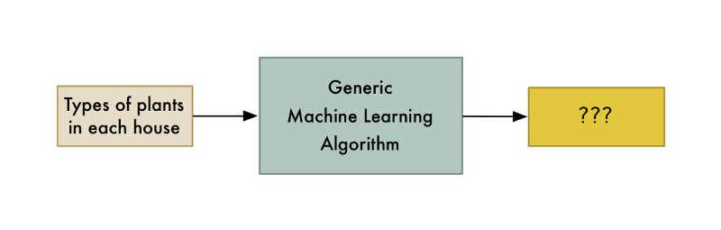
Once you start seeing how easily machine learning techniques can be applied to problems that seem really hard (like handwriting recognition), you start to get the feeling that you could use machine learning to solve any problem and get an answer as long as you have enough data. Just feed in the data and watch the computer magically figure out the equation that fits the data!
But it’s important to remember that machine learning only works if the problem is actually solvable with the data that you have.
Is machine learning magic?

Slide 13
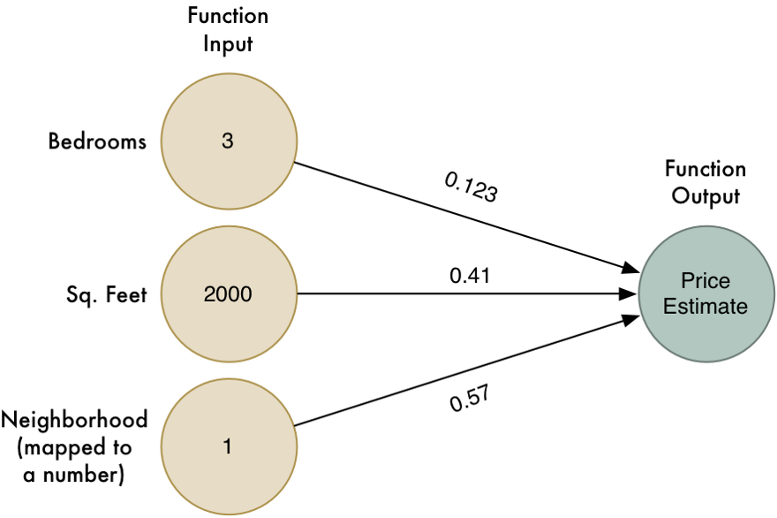
def estimate_house_sales_price(num_of_bedrooms, sqft, neighborhood):
price = 0
# a little pinch of this
price += num_of_bedrooms * 0.123
# and a big pinch of that
price += sqft * 0.41
# maybe a handful of this
price += neighborhood * 0.57
return price
In other words, we estimated the value of the house by multiplying each of its attributes by a weight. Then we just added those numbers up to get the house’s value.
This algorithm only works for simple problems where the result has a linear relationship with the input.
What if the neighborhood matters a lot for big houses and small houses but doesn’t matter at all for medium-sized houses. How could we capture that kind of complicated detail in our model?

Slide 14
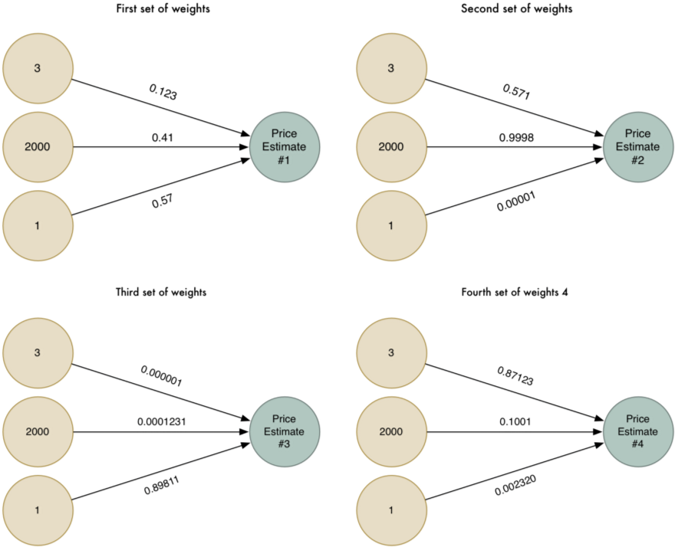
To be more clever, we could run this algorithm multiple times with different of weights that each capture different edge cases:

Slide 15
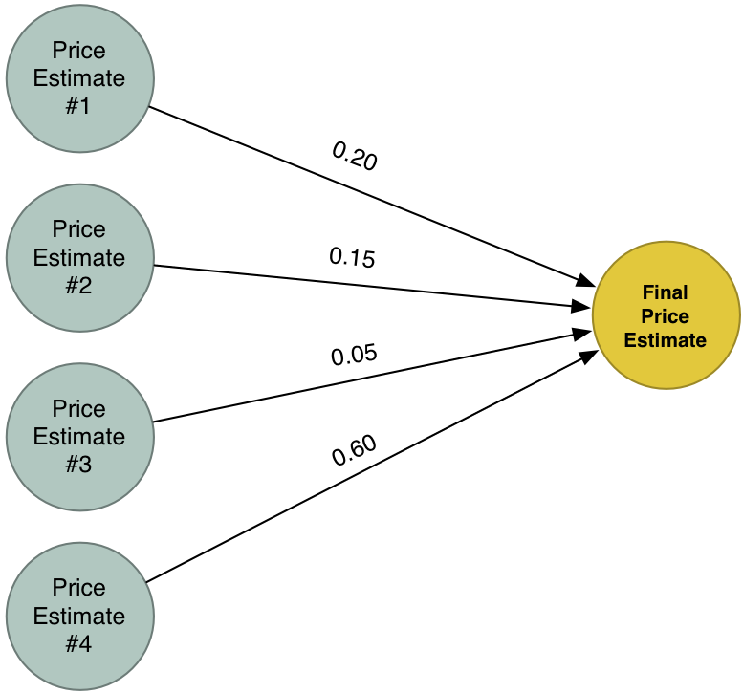
Our new Super Answer combines the estimates from our four different attempts to solve the problem. Because of this, it can model more cases than we could capture in one simple model.

Slide 16
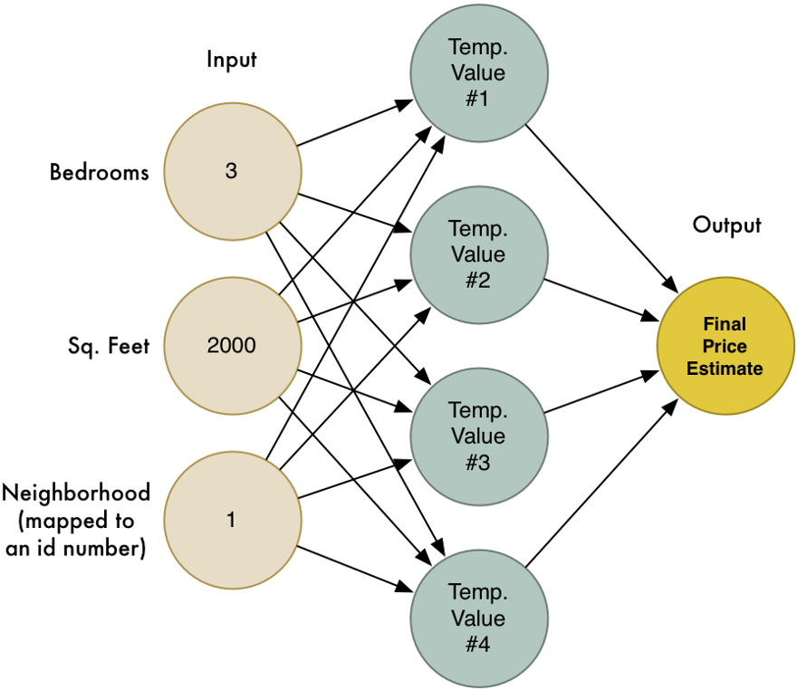
This is a neural network! Each node knows how to take in a set of inputs, apply weights to them, and calculate an output value. By chaining together lots of these nodes, we can model complex functions.
Let’s modify this same neural network to recognize handwritten text. But to make the job really simple, we’ll only try to recognize one letter — the numeral “8”.

Slide 17
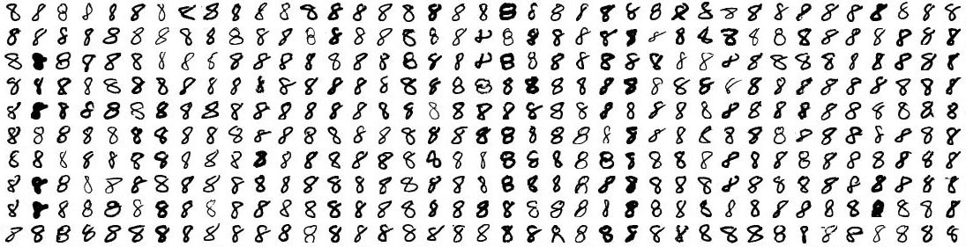
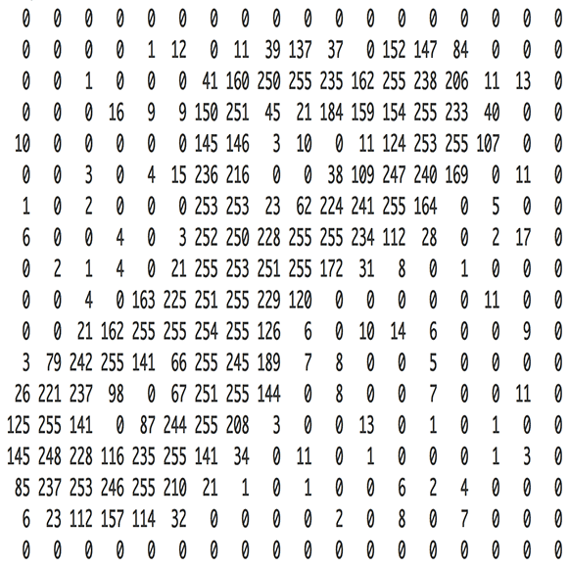

MNIST data set of handwritten numbers for this very purpose.
MNIST provides 60,000 images of handwritten digits, each as an 18x18 image.
Here are some “8”s from the data set:

Slide 18
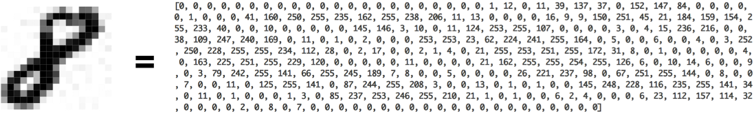
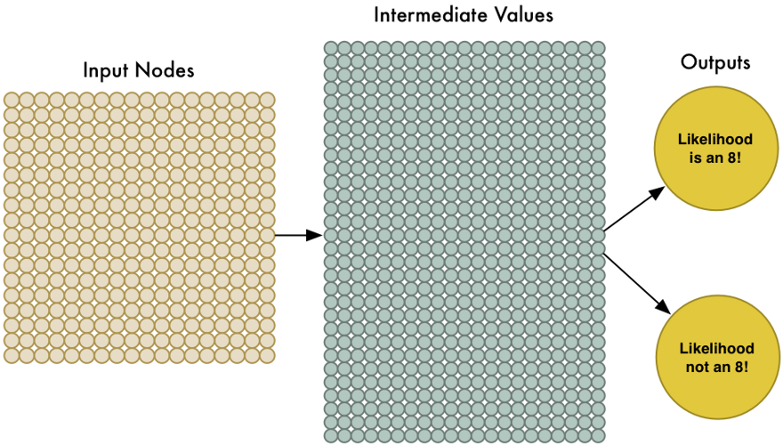
To feed an image into our neural network, we simply treat the 18x18 pixel image as an array of 324 numbers:
The first output will predict the likelihood that the image is an “8” and thee second output will predict the likelihood it isn’t an “8”. By having a separate output for each type of object we want to recognize, we can use a neural network to classify objects into groups.
So we need to train the neural network with images of “8”s and not-“8"s.
When we feed in an “8”, we’ll tell it the probability the image is an “8” is 100% and the probability it’s not an “8” is 0%. Vice versa for the counter-example images.

Slide 19
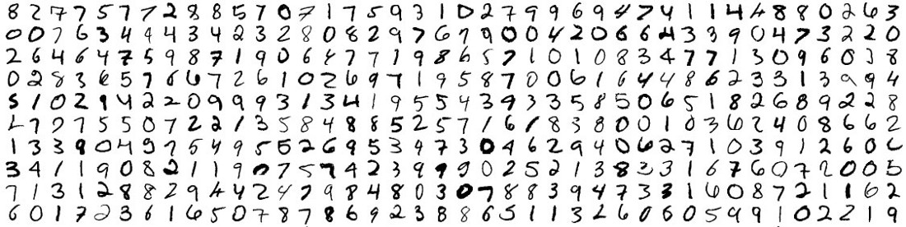
Training Data Set
When training of Neural Network is done, we’ll have a neural network that can recognize pictures of “8”s with a pretty high accuracy.
Welcome to the world of (late 1980’s-era) image recognition!
It’s really neat that simply feeding pixels into a neural network actually worked to build image recognition!
Machine learning is magic! …right?
Well, of course it’s not that simple.

Slide 20
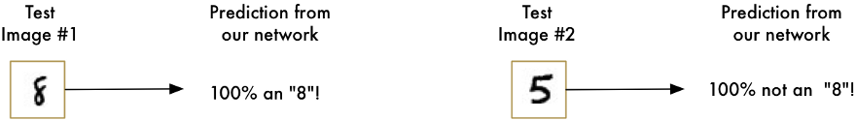
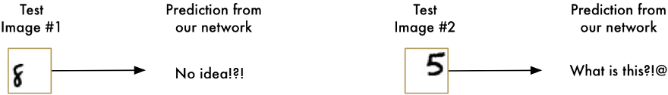
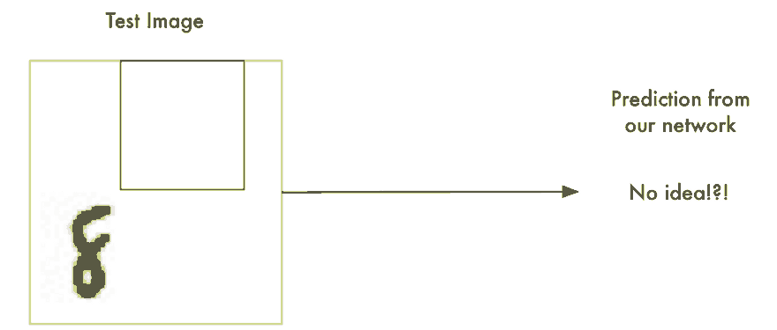
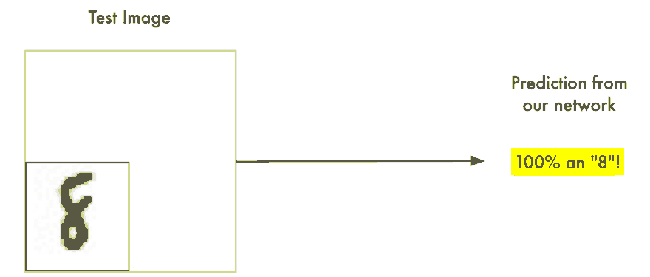
Real world problems are never that clean and simple.
So we need to figure out how to make our neural network work in cases where the “8” isn’t perfectly centered.
Sliding window Approach . It’s the brute force solution. It works well in some limited cases, but it’s really inefficient. You have to check the same image over and over looking for objects of different sizes.

Slide 21
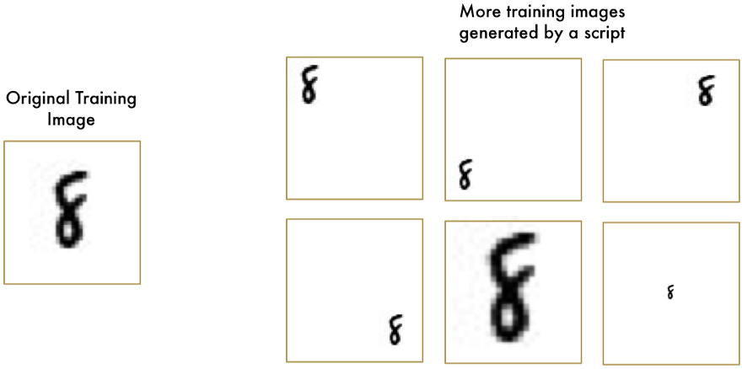
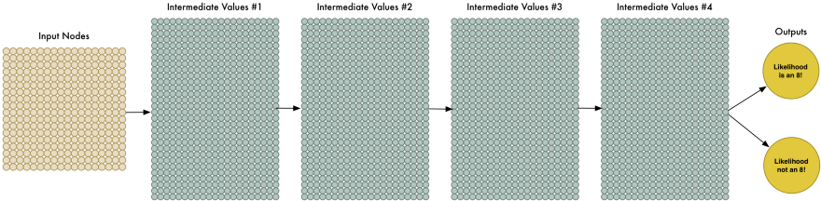
It doesn’t make sense to train a network to recognize an “8” at the top of a picture separately from training it to recognize an “8” at the bottom of a picture as if those were two totally different objects.
There should be some way to make the neural network smart enough to know that an “8” anywhere in the picture is the same thing without all that extra training.

Slide 22
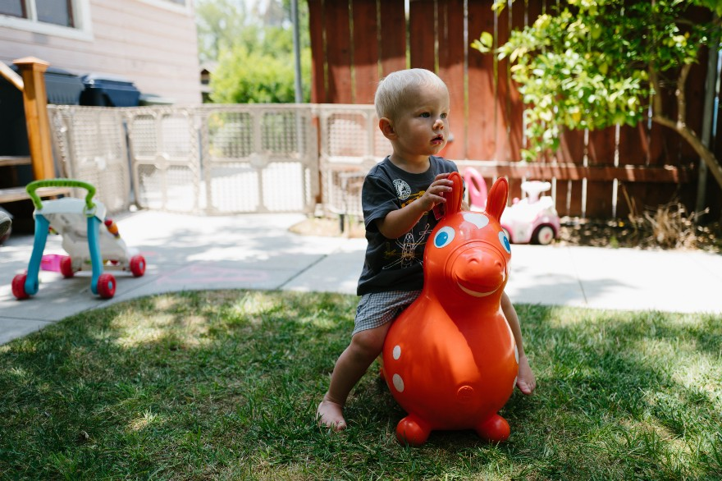
As a human, you instantly recognize the hierarchy in this picture
The ground is covered in grass and concrete
There is a child
The child is sitting on a bouncy horse
The bouncy horse is on top of the grass
Most importantly, we recognize the idea of a child no matter what surface the child is on. We don’t have to re-learn the idea of child for every possible surface it could appear on. But right now, our neural network can’t do this.
It thinks that an “8” in a different part of the image is an entirely different thing. This means it has to re-learn the identify of each object in every possible position.
We need to give our neural network understanding of translation invariance — an “8” is an “8” no matter where in the picture it shows up.
We’ll do this using a process called Convolution.

Slide 23
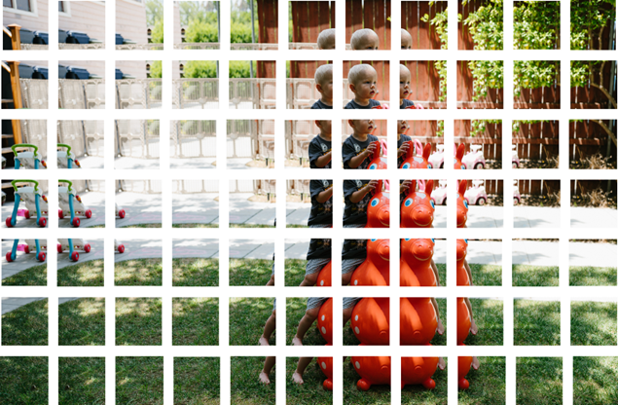
Step 1: Break the image into overlapping image tiles, pass a sliding window over the entire original image and save each result as a separate, tiny picture tile:
By doing this, we turned our original image into 77 equally-sized tiny image tiles.

Slide 24
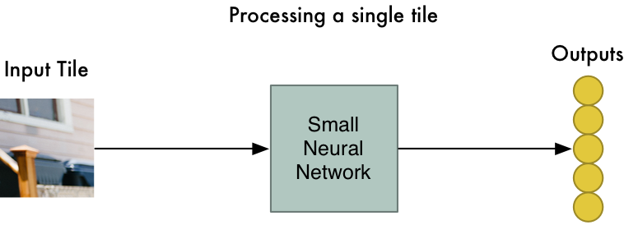
Step 2: Feed each image tile into a small neural network
Earlier, we fed a single image into a neural network to see if it was an “8”. We’ll do the exact same thing here, but we’ll do it for each individual image tile:
However, there’s one big twist: We’ll keep the same neural network weights for every single tile in the same original image.
In other words, we are treating every image tile equally. If something interesting appears in any given tile, we’ll mark that tile as interesting.

Slide 25
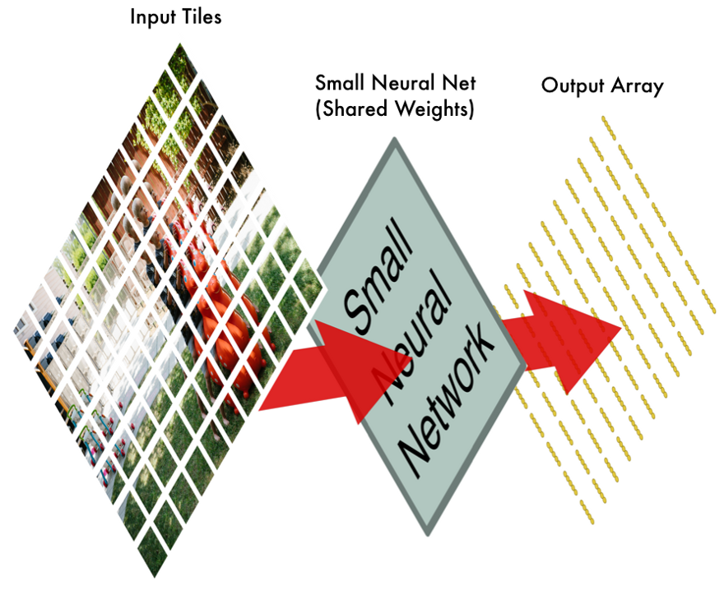
Step 3: Save the results from each tile into a new array
We don’t want to lose track of the arrangement of the original tiles. So we save the result from processing each tile into a grid in the same arrangement as the original image. It looks like this:
In other words, we’ve started with a large image and we ended with a slightly smaller array that records which sections of our original image were the most interesting.

Slide 26
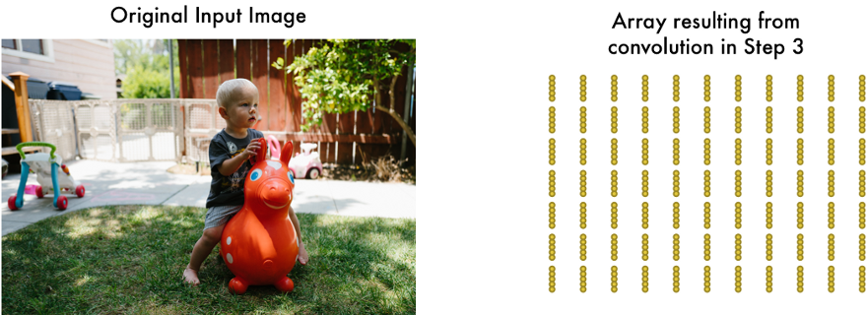
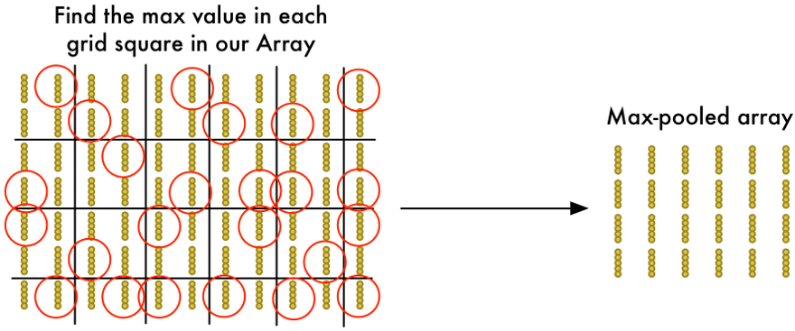
Step 4: Downsampling
The result of Step 3 was an array that maps out which parts of the original image are the most interesting. But that array is still pretty big:
To reduce the size of the array, we downsample it using an algorithm called max pooling. It sounds fancy, but it isn’t at all!

Slide 27
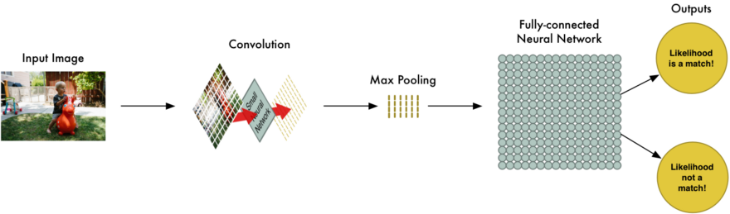
Final step: Make a prediction
So far, we’ve reduced a giant image down into a fairly small array.
That array is just a bunch of numbers, so we can use that small array as input into another neural network. This final neural network will decide if the image is or isn’t a match. To differentiate it from the convolution step, we call it a “fully connected” network.
So from start to finish, our whole five-step pipeline looks like this:

Slide 28
Adding Even More Steps
Our image processing pipeline is a series of steps: convolution, max-pooling, and finally a fully-connected network.
When solving problems in the real world, these steps can be combined and stacked as many times as you want! You can have two, three or even ten convolution layers. You can throw in max pooling wherever you want to reduce the size of your data.
The basic idea is to start with a large image and continually boil it down, step-by-step, until you finally have a single result. The more convolution steps you have, the more complicated features your network will be able to learn to recognize.

